Slide 1
Intellectual Property
'Who owns my polio vaccine? The people! Could you patent the sun?'
Salk (1914-1995), who developed the first effective anti- polio vaccine

Slide 2
Topics
Intellectual Property and Changing Technology
Copyright law
Copying Music, Movies, Software, and Books
Solutions (Good and Bad)
Free-Speech issues
Free Software
Software Patents

Slide 3
IP and Changing Technology
Intellectual Property relates to intangible creative work
Not necessarily the physical form on which it is stored or delivered.
Compare:
Physically owning a compact disc versus…
… owning the copyrights for the music on the CD.
Four types of protection:
Copyright: the right to copy a work
Patent: the right to use/recreate/manufacture an invention
Trademark: the right to use a word, phrase, sound
Trade secret: you don’t tell anybody, nobody should know

Slide 4

What are some things the entertainment industry has done to protect copyright?
Do you think these are justified?

Slide 5
Copyright
(In Canada) Copyrights expires after …
50 years after death of a person
50 years in case of a company
With some exceptions, copyright owners have the exclusive right to:
Make copies of the work
Produce derivative works
Distribute copies
Perform the work in public
Display the work in public

Slide 6
Examples of copyrighted work
Literary works
books, pamphlets, poems
other works consisting of text
computer programs (!)
Dramatic works
films, videos, plays, screenplays, scripts
Music works
Compositions (words & music, or music only)
Artistic works
Paintings, drawings, maps, photographs, sculptures, architectural works

Slide 7
Copyright vs. Patent
Copyright:
Protects works that owe their origin to the expressive efforts of an individual.
Key is that if the work is “original” (i.e., created independently) then it can be “copyrighted”.
Even if there is a closely similar work in existence.
Copyright owner has rights only against those who use their work without permission (i.e., defense against plagiarism).
Patents:
Protect the discoveries of inventors.
For as long as patent lasts, holder has a monopoly right.
This right prevents anyone from producing implementations of their invention, even if same discovery was made independently.

Slide 8
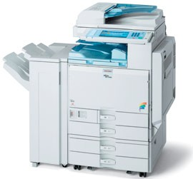
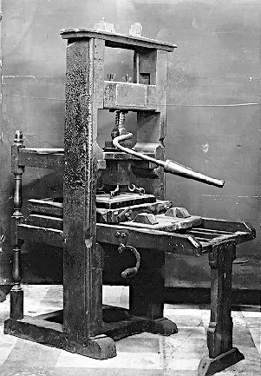
IP and changing technology
Problems for IP owners with newly available IT:
High-quality copying
High-quantity distribution
Faster / easier copying
Less expensive
But note!
Intellectual property law has always evolved…
… and has done so because of technological change.

Slide 9
Copyright Law: exceptions
Fair Dealing doctrine (= US “Fair Use”)
For some uses of copyright work, permission is not required.
Allows uses of copyright material contributing to the creation of new work.
… and which do not significantly affect sales of the material.
Allows some research and educational uses.
Also allows for news reporting and critiquing.
Guidelines for determining fair dealing are found in legal precedent.

Slide 10
Fair dealing: Six Factors
1.
Purpose of the Dealing
Research? Private study? Criticism?
Character of the Dealing
Single copies made? Multiple copies? Distributed widely? Or to a limited group?
Were copies destroyed after its purpose accomplished?
Amount of the Dealing
How much of the work is used?
What is the importance of the infringed work?
Alternatives to the Dealing
Are non-copyrighted versions available to the user?
Could the work be properly criticized without being copied?
Nature of the Work
Was the work published? Or unpublished? Secret?
Effect of Dealing on the Work
Is it likely to affect the market of the original work?
–
2.
–
–
–
3.
–
–
4.
–
–
5.
–
6.
–

Slide 11
Example: Who should win?
Political group organizes a web site where people post copies of news articles and
then comment on them, other readers also add comments.
Newspapers who originally published the articles sue for copyright infringement.

Slide 12
Example 2: Who should win?
Online service for checking essays for plagiarism
– Uploaded essays are stored in database and used for future checking
Some students sue the company for copyright infringement on their essay

Slide 13
Purpose of copyright?
Should it protect the author in something that is rightly theirs?
Berne Convention
Protection should be as long and broad as possible.
Should only provide those exceptions and limitations essential in the public interest.
Should it benefit the public by stimulating creation of artistic work?
Universal Copyright Convention (Geneva, 1952)
The law should only give as much protection as is necessary to induce authors to create and disseminate their works.
Should it do both?
Middle ground
Purpose of copyright is to stimulate the creation and public dissemination of works
And also to give their authors a generous reward for their contributions to society.
A delicate balance.

Slide 14
Fair Use Cases: US
1984: Sony v. Universal City Studios
Supreme Court ruled that non-commercial copying (recording) of a movie for viewing at a later time was fair use.
Court ruled that copying devices should not be banned if they have significant legal uses.
1992: Sega Enterprises, Ltd. v. Accolade, Inc.
Reverse engineering a complete program in order to produce new, creative work was ruled fair use.
In essence: Sega did not have a monopoly on selling games for its machines.
SENG 401: Social and Professional Issues
Intellectual Property: Slide 20

Slide 15
Copying: Music
Improved technology allows easy, fast, cheap and widespread copying of music on Web.
Entrepreneurs create businesses to facilitate storing and sharing of music files.
Many individuals set up free sites for music sharing, too.
US: RIAA (Recording Industry Association of America) continues to fight unauthorized copying of music.
Canada: CRIA (Canadian Recording Industry Association)
Launched a lawsuit in 2004 against 29 unnamed alleged music file sharers.
By May 2005: case heard by trial court and the appeals court
Both courts ruled that CRIA’s case was not strong enough
“The court concluded that the evidence created the risk that innocent persons might have their privacy invaded and also be named as defendants where it is not warranted.”
Courts instructed the CRIA to come back with stronger evidence.

Slide 16
Copying: Music (Canada)
Before 1998, copying any sound recording almost always infringed copyright
1998: Part VIII of the Copyright Act
You can legally make a copy of musical recordings for personal use
Does not legalize
Copies made for someone else
Copies of anything other than music recordings

Slide 17
Copying: Music (Canada)
Section VIII of the Copyright Act leads to some odd situations
It is legal to:
Lend a commercial CD to a friend, give him a blank CD-R, let him use your computer, and help him burn the CD-R which he can keep for private use.
Copy a commercial CD, keep the copy, and give your friend the original.
BUT, you cannot legally make the copy yourself and give your friend the copy.

Slide 18
Which should be fair use?
Copying a friend’s spreadsheet software to try out for 2 weeks, then either delete or buy your own copy?
Copying a computer game to play for 2 weeks, with no intention to buy later?
Others?

Slide 19
Copying: Books
Again, improved technology enables copying of books that:
is simple to perform
quick
cheap
Counterfeiters
Textbooks, novels, other printed matter
Profit is in not paying publishers or authors for their IP
E-books use encryption to reduce copying
But some of these schemes have been cracked.

Slide 20
Napster
Benefits (besides from being free)
Share music with other users
Obtain individual songs from a CD
Sample song from a CD
Access more songs (especially those unavailable commercially)
Legal Issues
Was copying and distributing music through Napster within fair- use guidelines?
If not, was Napster responsible for user actions?
US Supreme Court decision
Napster was guilty of encouraging and assisting copyright infringement

Slide 21
Solutions to IT's impact on copyright
There are three groups of solutions
Technological
Markets and Management
Regulations and Enforcement
Technological
Expiration date encoded.
Hardware dongle required.
“Activation” features.
Digital-rights management (DRM) – encryption and other schemes
Can prevent saving, printing, making more than N copies, distribution, extracting excerpts, ffw over commercials
SENG 401: Social and Professional Issues
Intellectual Property: Slide 30

Slide 22
Solutions… contd.
Markets and Management
Subscribe to services
Collect fees from users and large organizations.
Meter usage of copyrighted material on a network.
Offer discounts to educational users.
Educate the public about the value of copyrighted material produced by creators and publishers.
Regulations and Enforcement
US: The Digital Millennium Copyright Act (DMCA) and other laws.
Canada: Will there be a Canadian DMCA?
Enforce current laws and punish abusers.

Slide 23
Technology: Restrictions & Bans
In the past, lawsuits have delayed, restricted, or banned the release of new technologies
CD-recording devices
Digital Audio Tape (DAT) systems
DVD recorders
DVD players
MP3 players
Some governments or industry groups have created taxes or levies…
Goal: Reduce or prevent unauthorized copying and distribution of copyrighted material.
Further goal: Assist affected creators of this material.
Examples
Audio tapes, Blank CD-ROMs
CD recorders
Personal computers
Printers, Scanners
2011: The NDP wants a tax on all devices with a hard drive. Do you agree?

Slide 24
Technology: DRM?
Digital Rights Management
When combined with laws such as the US’s DMCA…
… can result in heavy fines or imprisonment (or both) for violators.
Legal & monetary consequences can be applied to:
those who pirate intellectual work
scientists and researchers of technology

Slide 25
Circumventing Digital Locks
Note: Canada does not have the equivalent of the DMCA
But we have come very, very close with Bill C-60 (tabled in 2005)
Now on the table again with C-32
Fair Dealing
Prohibiting the use of circumvention tools may block exercise of Fair Dealing rights
Free Speech
Prohibiting the sharing of information about circumvention of DRM or copy-protection schemes may violate freedom of speech.

Slide 26
Future of Copyright
Challenges to the principles of copyright
Methods to circumvent copy-protection schemes.
Peer-to-peer (P2P) file transfer.
Ethical position among some that if copying is either easy, or cheap online access is absent, then copying is okay.
Challenges to Fair Dealing
Technological (DRM) and legal (DMCA) restrictions.
Conflicting outcomes (e.g., reverse engineering case) in the courts.
Non-traditional uses (e.g., online teaching materials)

Slide 27
Free-Speech Issues
IP protection?
Or violation of free speech?
Copyright:
Unauthorized posting of copyrighted documents for purpose of criticizing and organization.
Trademark:
Domain names that infringe upon trademark claims.
Trade Secret
Posting internal documents to expose unfair labour or business practices.

Slide 28
Free Software
Notion of “free software” has been advocated by Richard Stallman
“Free” means “free from certain copyright restrictions”
Examples:
GNU project
Emacs
“free” compilers and utilities
Linux
Apache webserver tools
GNOME

Slide 29
Patents
Q: Should software be Copyrighted or Patented?
Copyrights:
Protect the expression of an idea in a fixed or tangible form.
Are cheap, easy to obtain, and last a long time.
Allow fair dealing of the intellectual property.
Patents:
Protect new, non-obvious, and useful processes.
Are expensive, difficult to obtain, and last for short periods of time (20 years in Canada & USA)
Allow licensing to other developers.

Slide 30
Copyright & software forms
Recall that software can take several forms:
source code
object code
microcode (i.e., within processors)
Each of these can be copyrighted
For instance, copyrighting object code deals with software piracy.
But what happens if:
The copyrighted source code is in C…
… yet someone rewrites it into Java?
Is copyright infringed?
US Courts have drawn no distinction between source and object code
Sculpture analogy: doesn’t matter if sculpture is in bronze or in marble

Slide 31
Copyright and software forms
But what about software versus hardware?
Software is copyrightable
Yet we know that the same software could be turned into hardware…
… and hardware falls under the purview of patent.
(Note: the hardwired version could not be copyrighted.)
Is software patentable?
1970s: US Supreme Court initially ruled software as unpatentable
That is: algorithms were deemed to constitute abstract ideas or methods
This placed software outside of patentable subject matter.
SENG 401: Social and Professional Issues
Intellectual Property: Slide 40

Slide 32
Change…
1981: US Supreme Court revisited their earlier ruling
“Diamond v. Diehr”
New position amended earlier one.
Software by itself is still unpatentable…
… but if tied to some physical component or substrate, it could be patentable.
This particular case covered a technique for curing rubber.
The device included some element that performed computerized calculations.
These determined when curing was done.

Slide 33
Patents
Possible patentable material:
machines
industrial processes
compositions of matter
articles of manufacture that are novel, useful, and non-obvious
Patents are obtained in many jurisdiction by submitting an application to a Patent Office
US: Patent and Trademark Office (PTO)
Canada: Patent Office
Patent must describe:
how to make the claimed invention
how to use it
claims delineating the inventions covered by the patent

Slide 34
Software Patents
US law since 1981:
chipping away at restrictions on software patents
“stretching” patent law to accommodate software
Examples: physical substrate
Software needs to produce some physical change in a machine.
Programs certainly do this
stored data in the form of computer memory (i.e., hardware with varying electrical or magnetic states)
moving from one such state to another is a physical change
Storing data or software code on a magnetic disk
Recognized a producing a novel and patentable article of manufacture.
That is, the disk with the stored data differs from the disk without it.

Slide 35
Algorithms & data structures
US 1998: State Street Bank & Trust vs. Signature Financial Group
Signature Financial obtained a patent on a “hub-and-spoke” method of running mutual funds.
This depended heavily on computer technology.
Idea:
Several mutual funds are the “spokes”; The single investment portfolio is the “hub”
Software determines the values of each fund based on its percentage of assets in the “hub”
Information is tracked on a daily basis (fund share pricing, tax accounting).
State Street Bank asked that this business process be judged unpatentable as it was just a mathematical algorithm.
A high-level court disagreed:
Court explicitly stated that business processes can form patentable subject matter
Consequence: algorithms and data structures are now considered by many to be “patentable subject matter”

Slide 36
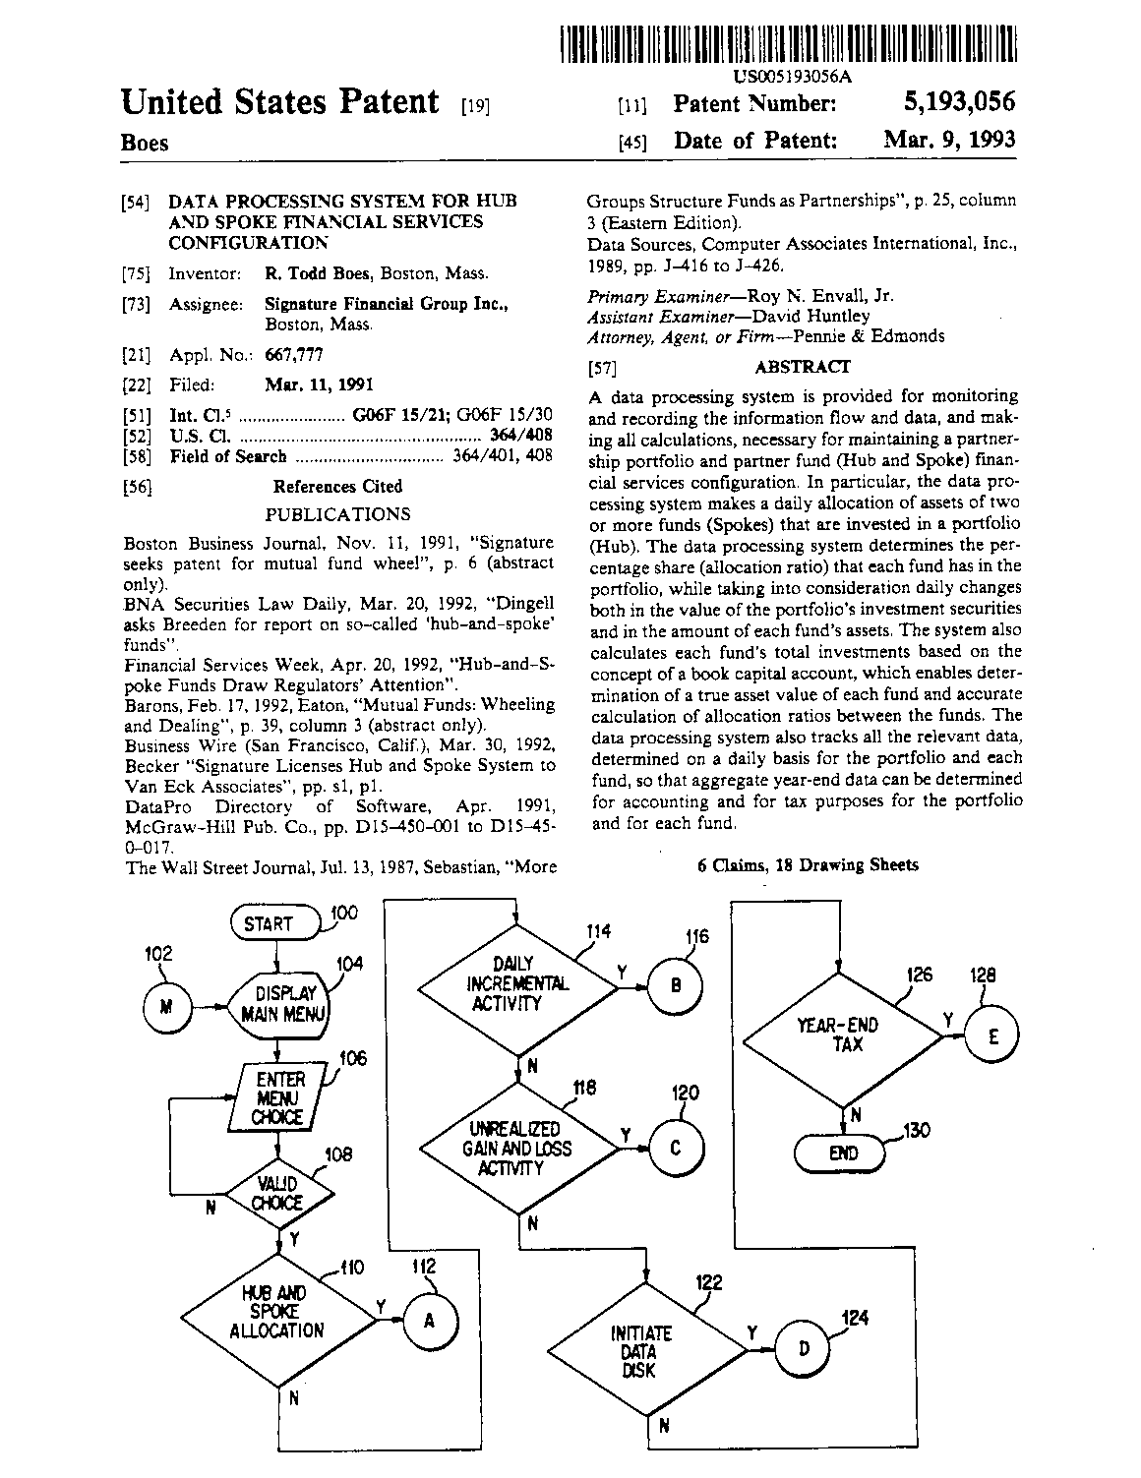
_{University of Victoria} SENG 401: Social and Professional Issues
_{Department of Computer Science} Intellectual Property: Slide 45
Cover page from Signature Financial Patent

Slide 37

Progress bar patent - Sony
A method of providing information about recorded media content having a beginning and end time, said method comprising: displaying a progress bar
having a first portion, said first portion graphically representing the duration of said recorded media content and having a first color; and displaying a second portion having a second color in said progress bar, said second portion graphically representing a section of said recorded media content that is viewed during a viewing session; wherein said second color is distinct from said first color; and wherein said second portion graphically tracks a navigation through said recorded media content being viewed in a trick mode.
Filed: August 25, 2004
United States Patent 7,290,698

Slide 38
How would you protect your software?
Patent, Copyright, or Trade secret?
Is it worth the time & $ to patent your algorithm?
Keep in mind – your patent is only as good as your ability to legally defend it
A patent is only effective in the country it is filed in – so you may need to file in many countries

Slide 39
Licensing
Microsoft is probably infringing on Sony’s progress bar patent
But Sony is probably infringing on some Microsoft patents
They sign licensing deals to allow each other to use the IP without risk of being sued
Holding lots of patents is a defensive strategy for big companies

Slide 40
Open source software
What are the benefits of open source software?
Drawbacks?
As a for-profit company, would you contribute?

Slide 41
Perspective on controversy
Computer Scientists and Software Engineers generally take stands against software patents.
This is perhaps to be expected.
Therefore we must beware of our use of “special pleading” arguments.
Example of such an argument:
“Software is unique, therefore we must find a unique mechanisms other than patents and copyright to protect it.”
Only to be followed by “Digital media should not be treated any differently with respect to fair dealing under copyright.”
IT professionals are (usually) not patent lawyers
Even legal scholars doing research on software patents may not have first-hand experience praticing patent law.
We should acknowledge our dislike of “unwanted” complexity.

Slide 42
Questions
Since patents are “property rights”, do they promote innovation?
Monopoly right with strict time limit
Some arguments against software patents are actually arguments against any patents.
Have patents evolved to address concerns raised by those who suspect software patents?
Recall that patents have been in existence for over 500 years.
Software has been around for a tenth of that time.
The infrastructure around software patents is being assembled, including better handling of infringement, examination, and identification of prior art.

Slide 43
Questions (continued)
Must the patent system be perfect?
Rhetorical question; but if there are too many mistakes in granting patents, the patent system will fail.
Patents may inhibit standards if holders do not agree to standard licensing agreements.
QWERTY keyboard; automobile controls arrangement – both were patented, but did not inhibit standards creation.
Is software different enough from other technologies that it is suitable for special treatment?
Other complex systems benefit from patents (i.e., airplane design, chip fabs, oil refineries)
Other small innovative companies benefit from patents (i.e., the “cottage industry” argument)

Slide 44
Questions (continued)
Is the Open-Source model superior to patent systems?
Open-source licenses are based on the copyright model.
However, some open-source projects (such as Linux) are based on innovative ideas developed by companies using patents (AT&T and UNIX).
Should difficulties in identifying “prior art” motivate alternate models for software IP?
Many horror stories of software patents are derived from the early days of such patents.
The US PTO has steadily improved its search for prior art.
Political dimension: How well do we fund our patent offices?

Slide 45
Questions (continued)
Is it fair to pose the question, “Is software patentable?”
This may now be a moot point.
Software has been patented now for twenty years or so.
There is now a lot of motivation for society to preserve the concept of such patents.
There also exists a huge pool of experts who know patent law as it applies to software.

